Slide 1

Image Reconstruction from EEG signals using ML/DL
Students: Dang Hoang Lan, Ngo Anh Huyen
Instructor: Nguyen Viet Dung
From Scalemind Research Institute

Slide 2
WHAT HAVE WE DONE?
Explore IEEE open-source Dataset:
Data set has 100 files EEG bdf raw files: Sampling frequency – 4096Hz
40,000 images were partitioned into 100 sets of 400 images each
Each set has 400 events (EEG epochs) that should later be segmented and exported
Initial preprocessing
Resample data: 4096Hz down to 1024Hz
Bandpass filter apply (14-71Hz)
Create 2 versions of preprocessed, segmented EEG data
(Using MNE-Python) ICA applied
(Using EEGLab-Matlab) Without ICA applied

Slide 3
A. Preprocessing Method

Slide 4
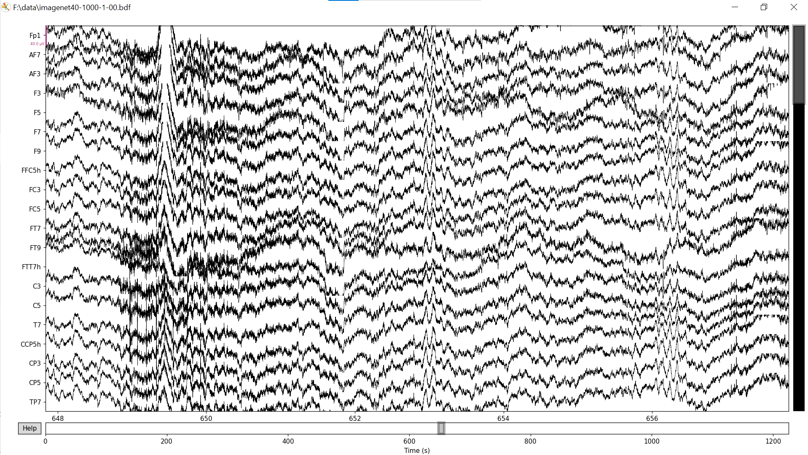
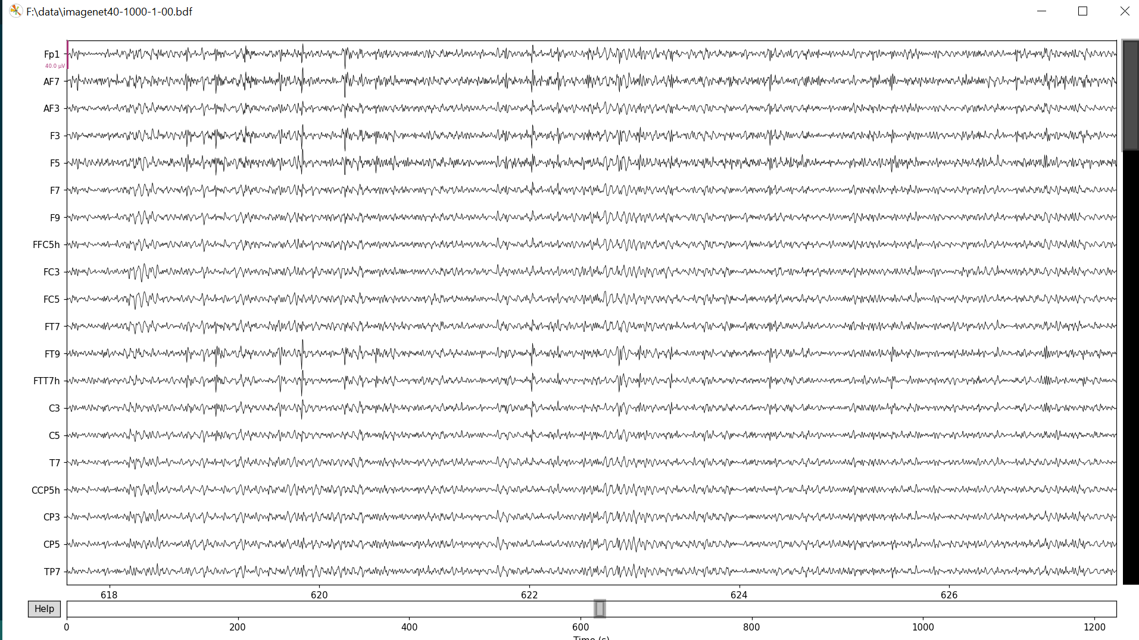
Preprocessing Method (Band pass filter)
Band pass filter
A band-pass filter is the combination of a low-pass filter and a high-pass filter, it removes all the frequencies outside of the frequency band of interest.

Slide 5
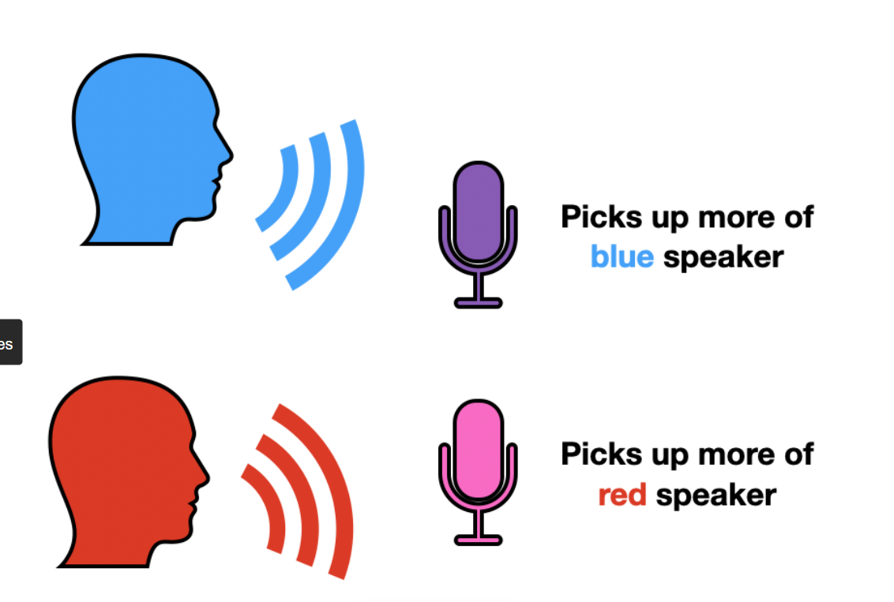
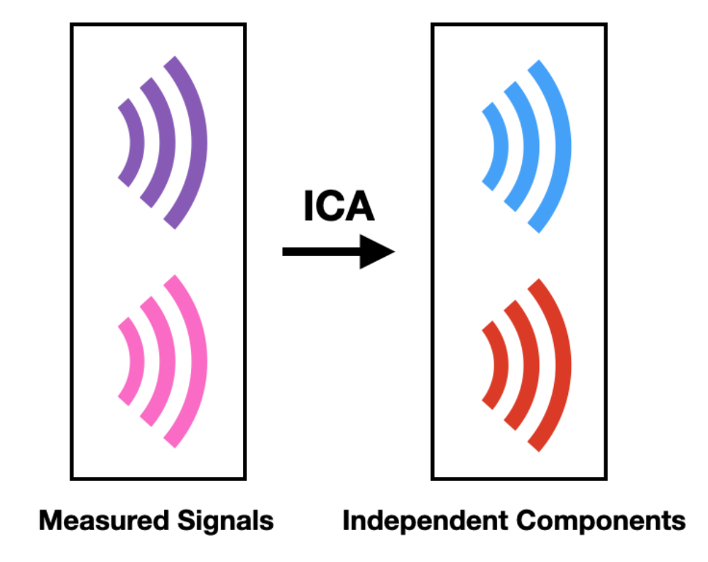
Preprocessing Method (ICA)
ICA (Independent Component Analysis)
Def: ICA is a signal preprocessing method to separate independent sources linear mixed in several sensors.
Cocktail Party Problem

Slide 6
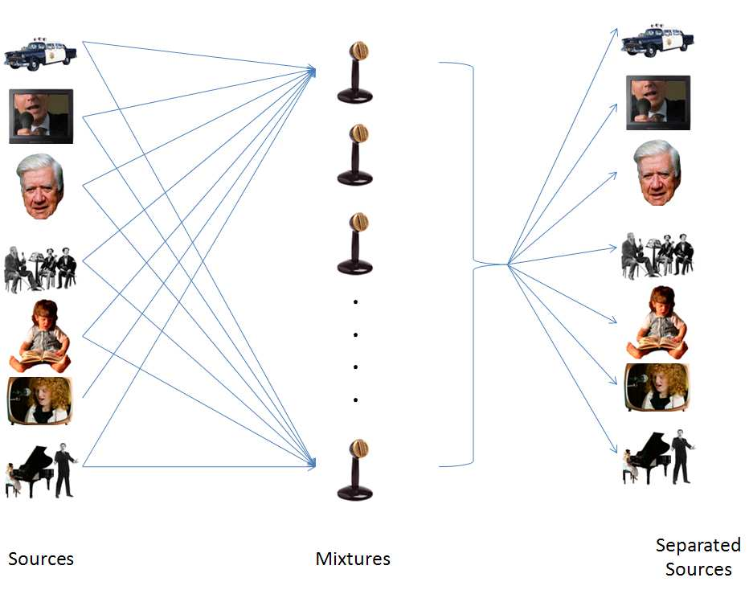
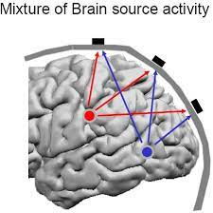
Preprocessing Method (ICA)
Why use?

Slide 7
B. Paper Review

Slide 8
We review 7 papers of related methods
Paper | Year | Author
Generative Adversarial Networks Conditioned by Brain Signals | 2017 | S. Palazzo et al.
Brain2Image: Converting Brain Signals into Images | 2017 | I. Kavasidis et al.
Natural image reconstruction from brain waves: a novel visual BCI system with native feedback | 2019 | Grigory Rashkov et al.
Decoding EEG by Visual-guided Deep Neural Networks | 2019 | Zhicheng Jiao et al.
Brain-media: A Dual Conditioned and Lateralization Supported GAN (DCLS-GAN) towards Visualization of Image-evoked Brain Activities | 2020 | Ahmed Fares et al.
Verifying Design through Generative Visualization of Neural Activities | 2021 | Pan Wang et al.
See What You See: Self-supervised Cross-modal Retrieval of Visual Stimuli from Brain Activity | 2022 | Zesheng Ye et al.

Slide 9
MOST OF THE PROPOSED METHODS UTILIZE A 2-STEP APPROACH:
Step 1. Learning EEG visual-related features
Step 2. Image Generation
Autoencoder-based approach
GAN-based approach
Image Retrieval approach

Slide 10
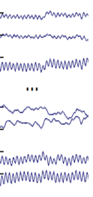
STEP 1. LEARNING EEG VISUAL-RELATED FEATURES
EEG encoder/ feature mapper
Visual class (act as supervised label)
EEG feature vector
EEG signals

Slide 11
STEP 1. LEARNING EEG VISUAL-RELATED FEATURES
Paper | Year | Best approach
Generative Adversarial Networks Conditioned by Brain Signals | 2017 | LSTM+ 1FC
Brain2Image: Converting Brain Signals into Images | 2017 | LSTM+ 1FC
Natural image reconstruction from brain waves: a novel visual BCI system with native feedback | 2019 | LSTM (with attention) + 2FC
Decoding EEG by Visual-guided Deep Neural Networks | 2019 | CNN (Visual guided approach)
Brain-media: A Dual Conditioned and Lateralization Supported GAN (DCLS-GAN) towards Visualization of Image-evoked Brain Activities | 2020 | Bi-directional LSTM (with 1 extra attention gate)
Verifying Design through Generative Visualization of Neural Activities | 2021 | LSTM + 2FC
See What You See: Self-supervised Cross-modal Retrieval of Visual Stimuli from Brain Activity | 2022 | TGCN (temporal graph convolutional network)

Slide 12
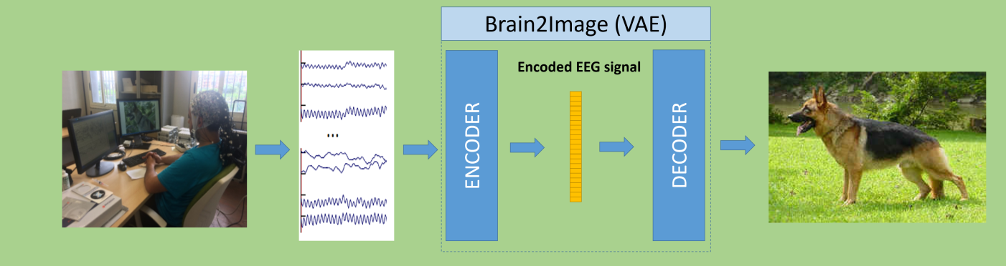
STEP 2. IMAGE GENERATION
Autoencoder-based approach
Brain2Image: Converting Brain Signals into Images, 2017, S. Palazzo et al.

Slide 13
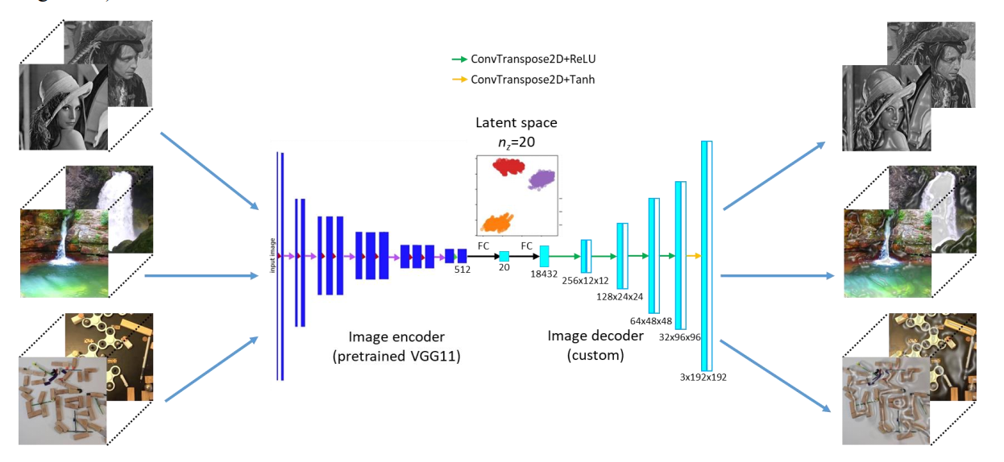
STEP 2. IMAGE GENERATION
Autoencoder-based approach
Natural image reconstruction from brain waves: a novel visual BCI system with native feedback, 2019, Grigory Rashkov et al.

Slide 14
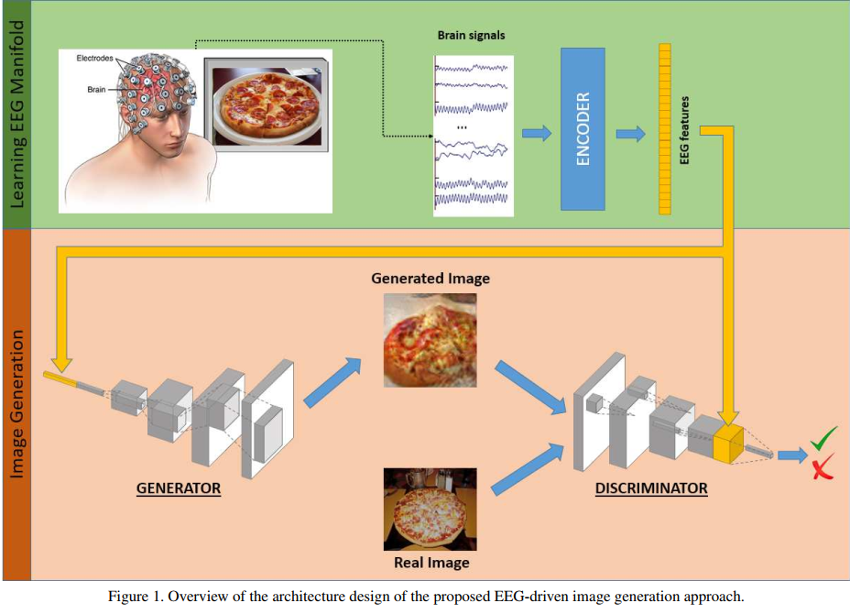
STEP 2. IMAGE GENERATION
GAN-based approach
Generative Adversarial Networks Conditioned by Brain Signals, 2017, S. Palazzo et al.
cGAN (conditional GAN) Model
cGAN (conditional GAN) Model
a type of GAN that also takes advantage of labels during the training process

Slide 15
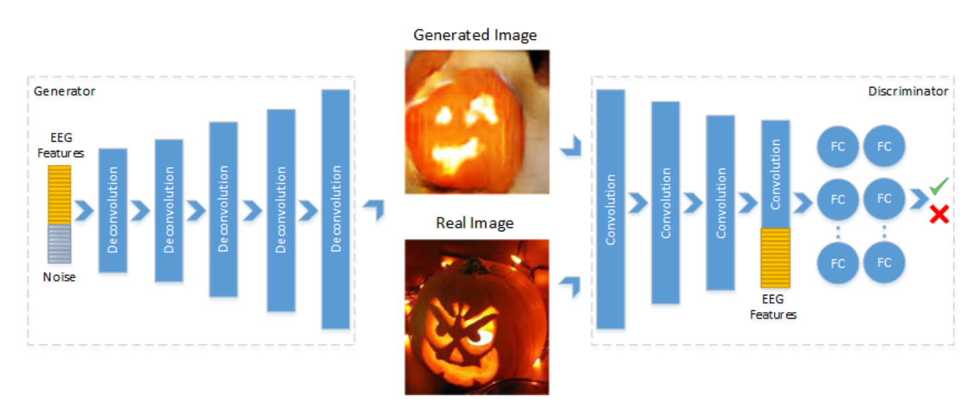
STEP 2. IMAGE GENERATION
GAN-based approach
Brain2Image: Converting Brain Signals into Images, 2017, S. Palazzo et al.
DC-GAN Model
128-dimensional EEG features are concatenated into the generator’s input layer & the last convolution layer of the discriminator

Slide 16
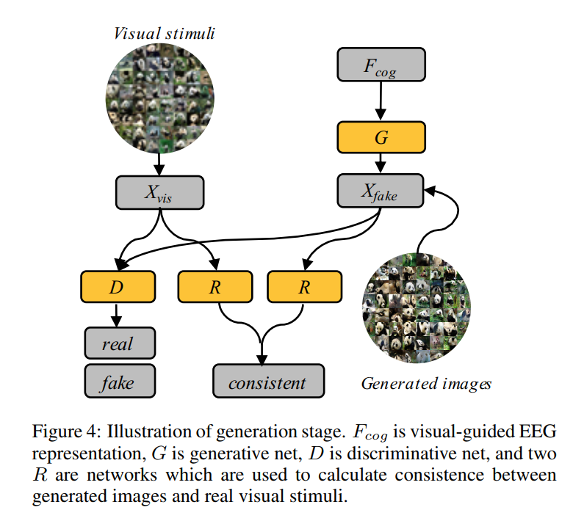
STEP 2. IMAGE GENERATION
GAN-based approach
Decoding EEG by Visual-guided Deep Neural Networks, 2019, Zhicheng Jiao et al.
Improved DC-GAN Model
Introduce two representative networks R to maintain consistency of visual components between Xfake and Xvis

Slide 17
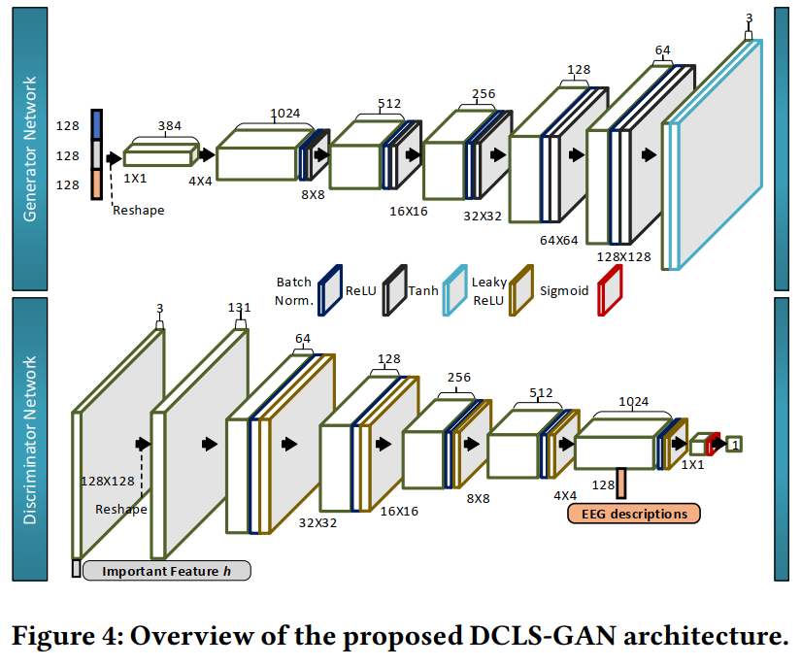
STEP 2. IMAGE GENERATION
GAN-based approach
Brain-media: A Dual Conditioned and Lateralization Supported GAN (DCLS-GAN) towards Visualization of Image-evoked Brain Activities, 2020, Ahmed Fares et al.
DCLS-GAN Model
Add the combined-conditional vector, including EEG descriptions (y) and the visual features (h) into the generator’s input layer

Slide 18
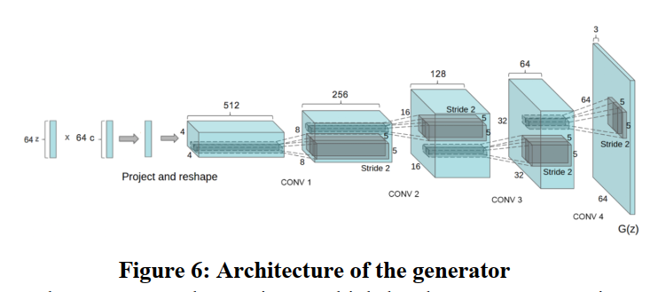
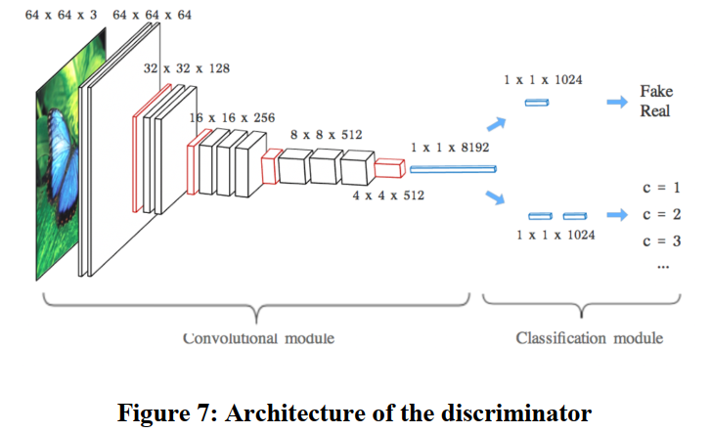
STEP 2. IMAGE GENERATION
GAN-based approach
Verifying Design through Generative Visualization of Neural Activities, 2021, Pan Wang et al.
ACGAN Model
Similar to cGAN (the generator inputs are noise and its label).
For ACGAN, the discriminator’s output is the probability that the image is real or fake & its class label

Slide 19
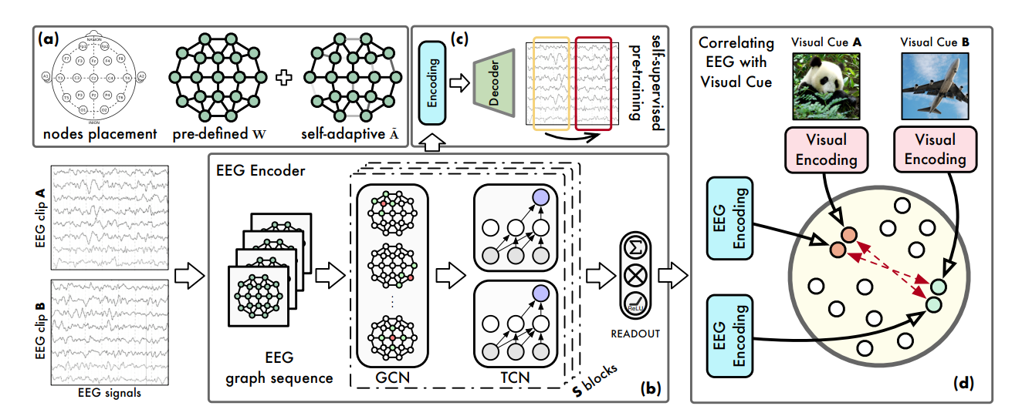
STEP 2. IMAGE GENERATION
Image Retrieval approach
See What You See: Self-supervised Cross-modal Retrieval of Visual Stimuli from Brain Activity, 2022, Zesheng Ye et al.
Correlating EEG with Visual cues (contrastive, cross-modal learning)

Slide 20
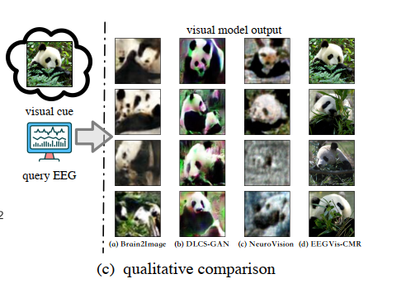
STEP 2. IMAGE GENERATION
Image Retrieval approach
See What You See: Self-supervised Cross-modal Retrieval of Visual Stimuli from Brain Activity, 2022, Zesheng Ye et al.
Performing Image Retrieval after cross-modal learning

Slide 21
EVALUATION METRICS
Classification accuracy
From the nature of experiment’s setup, the image training dataset is mostly balanced: equal number of images in each class
Can use classification accuracy to classify output visual classes on:
EEG encoder
generative model’s output

Slide 22
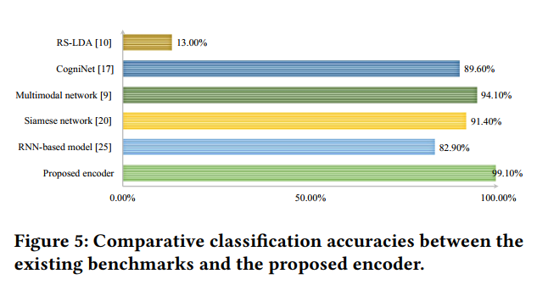
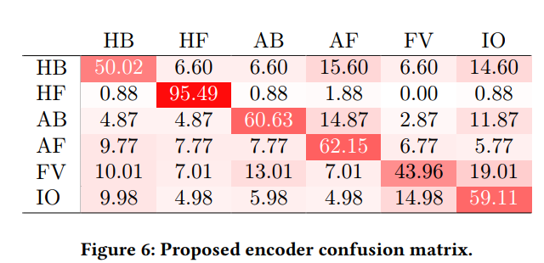
EVALUATION METRICS
Classification accuracy
Brain-media: A Dual Conditioned and Lateralization Supported GAN (DCLS-GAN) towards Visualization of Image-evoked Brain Activities, 2020, Ahmed Fares et al.

Slide 23
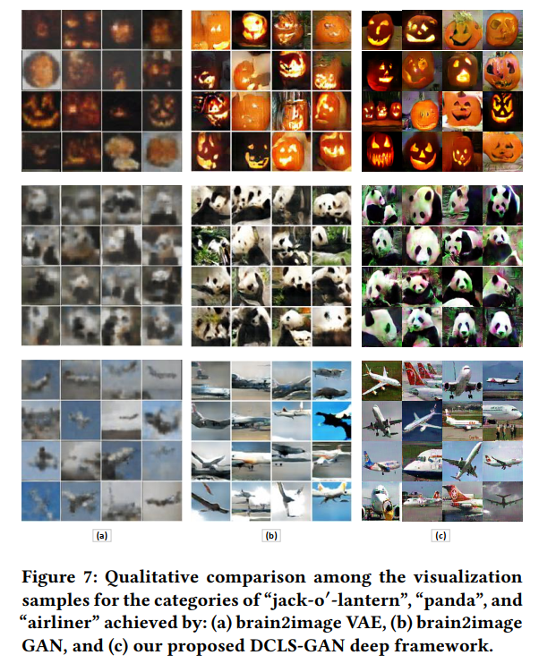
EVALUATION METRICS
Qualitative measurement (by human’s subjective perception)
Brain-media: A Dual Conditioned and Lateralization Supported GAN (DCLS-GAN) towards Visualization of Image-evoked Brain Activities, 2020, Ahmed Fares et al.

Slide 24
EVALUATION METRICS
Qualitative measurement (by human’s subjective perception)
Brain-media: A Dual Conditioned and Lateralization Supported GAN (DCLS-GAN) towards Visualization of Image-evoked Brain Activities, 2020, Ahmed Fares et al.

Slide 25
EVALUATION METRICS
Inception Score (IS)
Inception Score is an objective metric for evaluating the quality of generated images, specifically synthetic images output by generative adversarial network models.
The score measures two things:
+ Image Quality (Do images look like a specific object?)
+ Image Diversity (Is a wide range of objects generated?)
The inception score has a lowest value of 1.0 and a highest value of the number of classes supported by the classification mode
A higher score is better

Slide 26
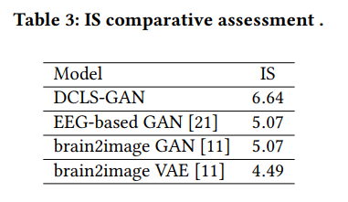
EVALUATION METRICS
Inception Score (IS)
Brain-media: A Dual Conditioned and Lateralization Supported GAN (DCLS-GAN) towards Visualization of Image-evoked Brain Activities, 2020, Ahmed Fares et al.

Slide 27
C. Conclusions

Slide 28
CONCLUSIONS
Raw EEG data mostly requires minimal preprocessing (resampling, bandpass filter). ICA, if performed, should be used with caution to avoid data loss.
EEG encoders mostly utilize LSTM models, with customed changes
For generative models:
GAN-based approaches generally perform better than AE/VAE-based approaches (both from qualitative comparison and IS score)
Image Retrieval approach is a unique approach but quite promising

Slide 29
FUTURE PLANS
Create pytorch model from preprocessed EEG segments & corresponding ImageNet dataset
Implement most promising methods on EEG encoder & generative models
EEG encoder: LSTM
Generative models:
GAN-based methods: ACGAN; combined feature vector added in generator’s and discriminator’s layers

Slide 30
COMMENTS
View images in separate channels
Can edit images into different format
HSI (hue saturation intensity)
Resampling using average strategy (average pooling??)
Segment average (moving average and down-sampling)

Slide 31
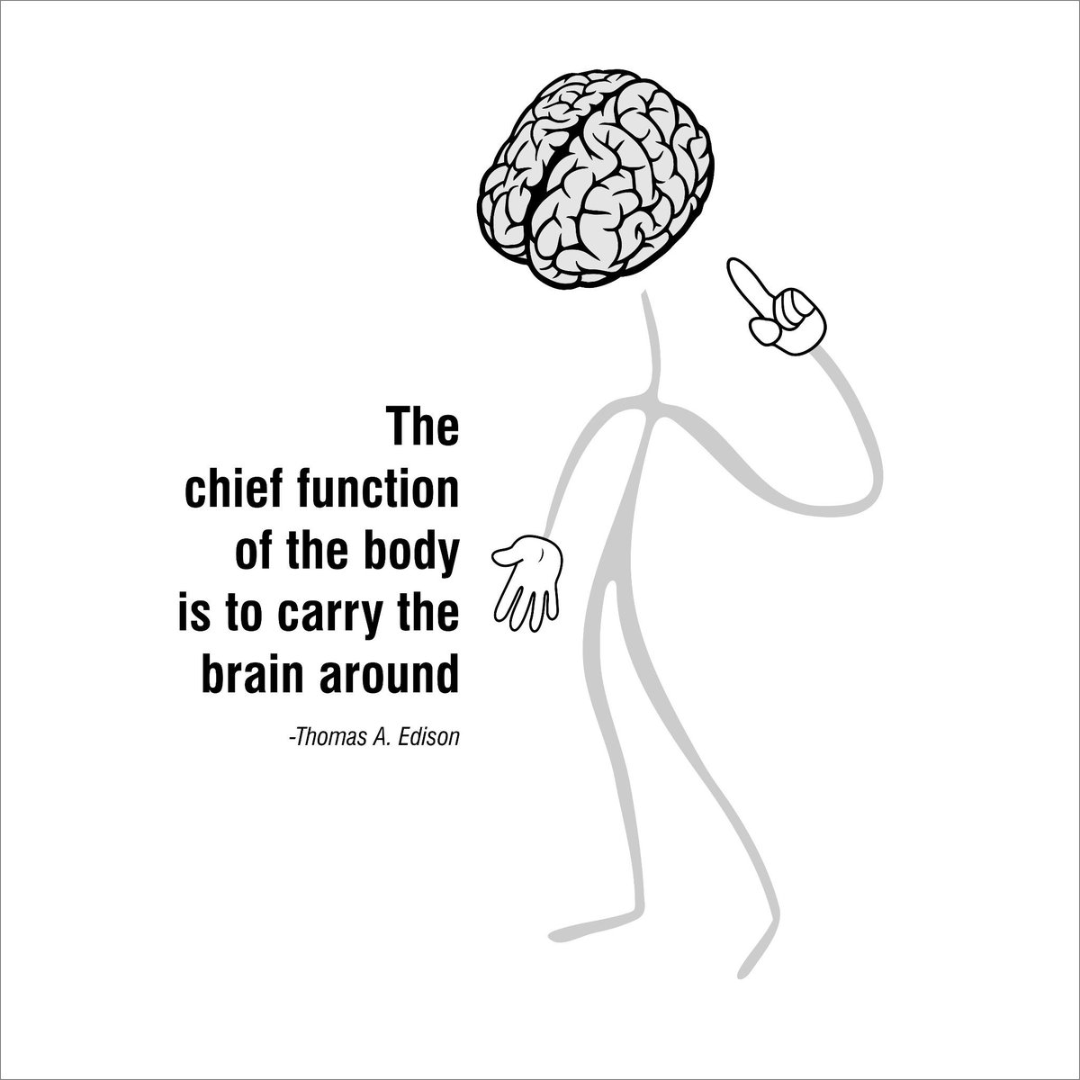

Slide 33
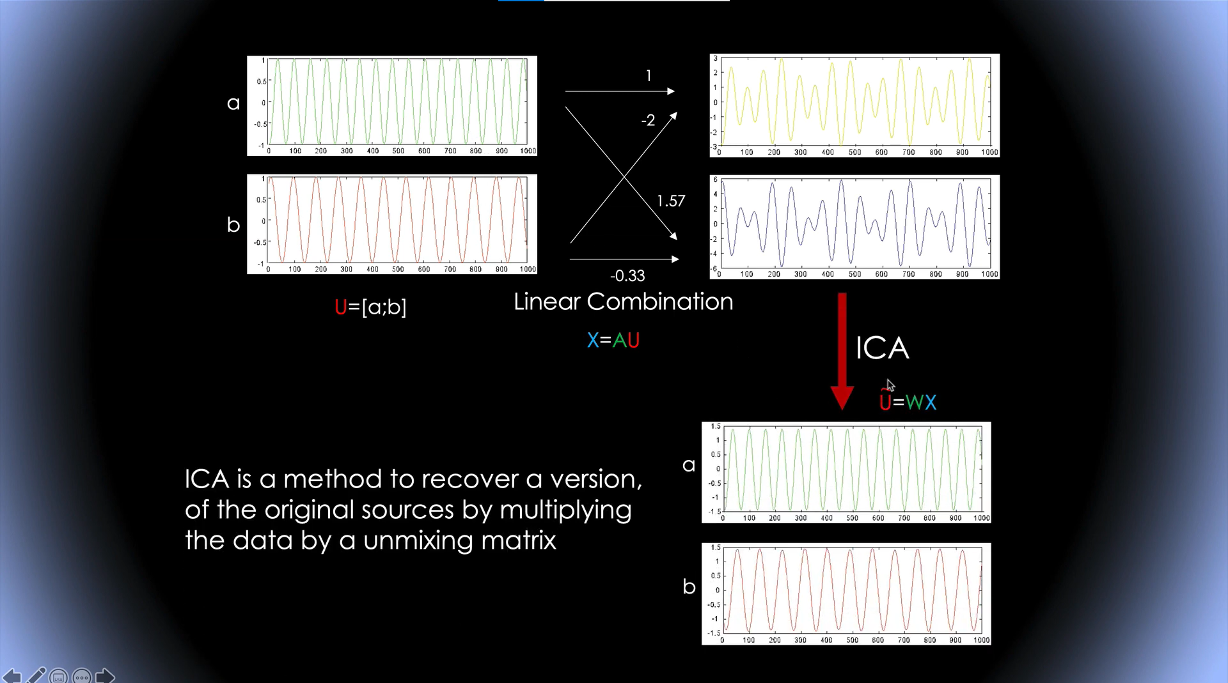
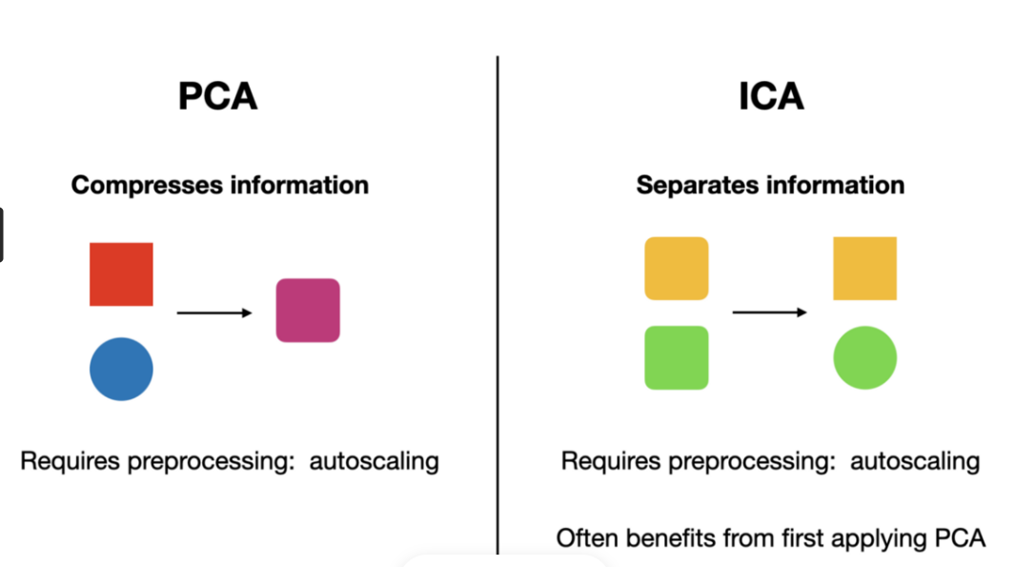
Preprocessing Method (ICA)
How does it work?
ICA is a method to recover a version, of the original sources by multiplying data by a unmixing matrix
U=WX
X: Data (channels x time)
U: ICA sources activities (components x times)
W: ICA unmixing matrix (components x channels)
While PCA simply decorrelates the outputs (using an orthogonal matrix W), ICA attempt to make the outputs statistically independent, while placing no constraints on matrix W.

Slide 34
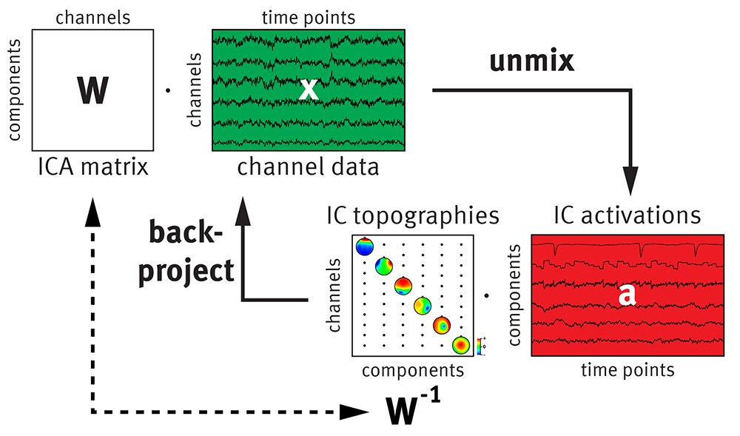
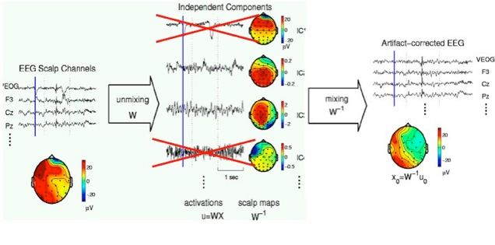
Preprocessing Method (ICA)
ICA applied to EEG signal preprocessing

